Slide 1
Object Oriented Programming Lecture - 27
Prof. Varsha Dange

Slide 2
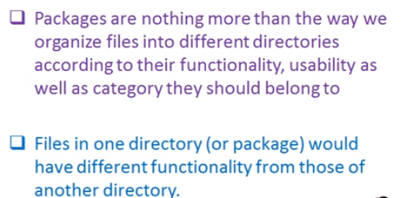

Packages in Java

Slide 3
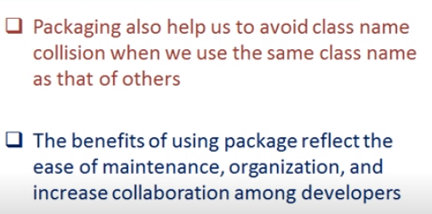
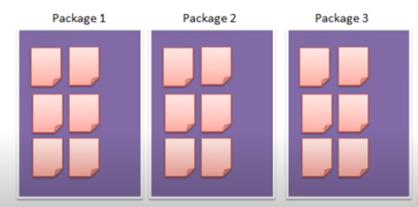
Advantages

Slide 4
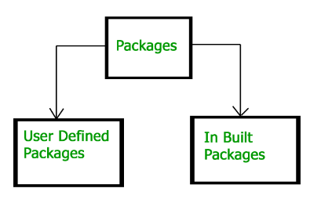
Types of packages

Slide 5
Built-in Packages
These packages consist of a large number of classes which are a part of Java API.
Some of the commonly used built-in packages are:
1) java.lang: Contains language support classes(e.g classed which defines primitive data types, math operations).
This package is automatically imported.

Slide 6
Contd..
2) java.io: Contains classed for supporting input / output operations.
3) java.util: Contains utility classes which implement data structures like Linked List, Dictionary and support ; for Date / Time operations.
4) java.applet: Contains classes for creating Applets.
5) java.awt: Contain classes for implementing the components for graphical user interfaces (like button , ;menus etc).
6) java.net: Contain classes for supporting networking operations.

Slide 7
User-defined packages
These are the packages that are defined by the user.
Eg- First we create a directory myPackage
Then create the MyClass inside the directory with the first statement being the package names.
package myPackage;
public class MyClass
{--------}

Slide 8
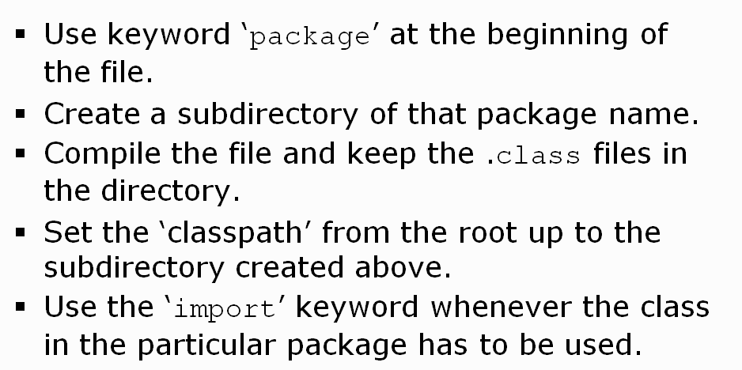
Steps for creating packages

Slide 9
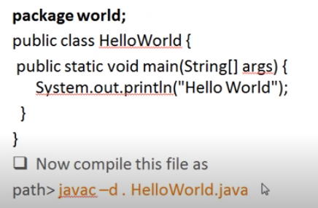
Contd…
If Run program on command prompt-
Run:---- java world.Helloworld

Slide 10
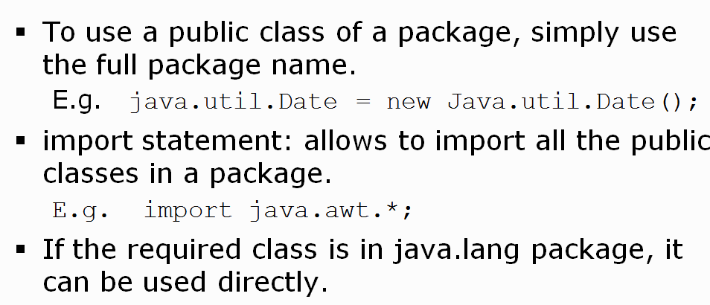
Using Package

Slide 11
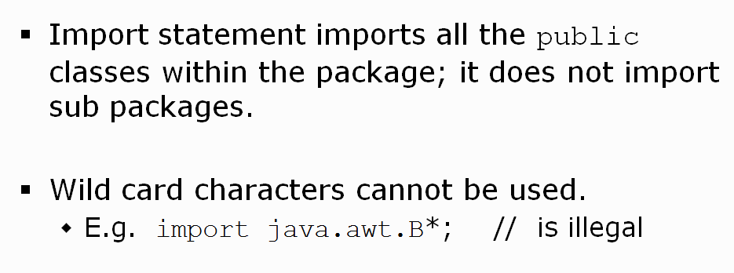
Characteristics of Package

Slide 12
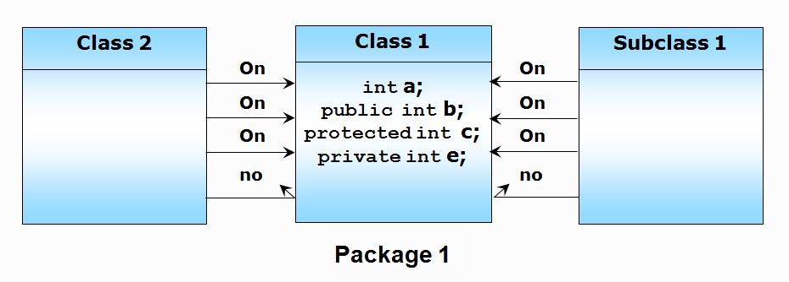
Accessibility from within same package

Slide 13
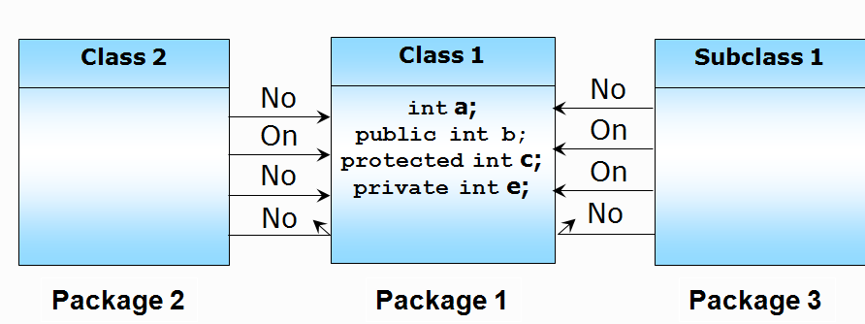
Accessibility from different package

